Slide 1
Linear probing

Slide 2
Outline
Our first scheme for open addressing:
Linear probing—keep looking ahead one cell at a time
Examples and implementations
Primary clustering
Is it working looking ahead every k entries?

Slide 3
Linear Probing
The easiest method to probe the bins of the hash table is to search forward linearly
Assume we are inserting into bin k:
If bin k is empty, we occupy it
Otherwise, check bin k + 1, k + 2, and so on, until an empty bin is found
If we reach the end of the array, we start at the front (bin 0)

Slide 4
Linear Probing
Consider a hash table with M = 16 bins
Given a 3-digit hexadecimal number:
The least-significant digit is the primary hash function (bin)
Example: for 6B72A₁₆ , the initial bin is A and the jump size is 3

Slide 5
Insertion
Insert these numbers into this initially empty hash table:
19A, 207, 3AD, 488, 5BA, 680, 74C, 826, 946, ACD, B32, C8B, DBE, E9C
0 | 1 | 2 | 3 | 4 | 5 | 6 | 7 | 8 | 9 | A | B | C | D | E | F

Slide 6
Example
Start with the first four values:
19A, 207, 3AD, 488
0 | 1 | 2 | 3 | 4 | 5 | 6 | 7 | 8 | 9 | A | B | C | D | E | F

Slide 7
Example
Start with the first four values:
19A, 207, 3AD, 488
0 | 1 | 2 | 3 | 4 | 5 | 6 | 7 | 8 | 9 | A | B | C | D | E | F
 |  |  |  |  |  |  | 207 | 488 |  | 19A |  |  | 3AD

Slide 8
Example
Next we must insert 5BA
0 | 1 | 2 | 3 | 4 | 5 | 6 | 7 | 8 | 9 | A | B | C | D | E | F
 |  |  |  |  |  |  | 207 | 488 |  | 19A |  |  | 3AD

Slide 9
Example
Next we must insert 5BA
Bin A is occupied
We search forward for the next empty bin
0 | 1 | 2 | 3 | 4 | 5 | 6 | 7 | 8 | 9 | A | B | C | D | E | F
 |  |  |  |  |  |  | 207 | 488 |  | 19A | 5BA |  | 3AD

Slide 10
Example
Next we are adding 680, 74C, 826
0 | 1 | 2 | 3 | 4 | 5 | 6 | 7 | 8 | 9 | A | B | C | D | E | F
 |  |  |  |  |  |  | 207 | 488 |  | 19A | 5BA |  | 3AD

Slide 11
Example
Next we are adding 680, 74C, 826
All the bins are empty—simply insert them
0 | 1 | 2 | 3 | 4 | 5 | 6 | 7 | 8 | 9 | A | B | C | D | E | F
680 |  |  |  |  |  | 826 | 207 | 488 |  | 19A | 5BA | 74C | 3AD

Slide 12
Example
Next, we must insert 946
0 | 1 | 2 | 3 | 4 | 5 | 6 | 7 | 8 | 9 | A | B | C | D | E | F
680 |  |  |  |  |  | 826 | 207 | 488 |  | 19A | 5BA | 74C | 3AD

Slide 13
Example
Next, we must insert 946
Bin 6 is occupied
The next empty bin is 9
0 | 1 | 2 | 3 | 4 | 5 | 6 | 7 | 8 | 9 | A | B | C | D | E | F
680 |  |  |  |  |  | 826 | 207 | 488 | 946 | 19A | 5BA | 74C | 3AD

Slide 14
Example
Next, we must insert ACD
0 | 1 | 2 | 3 | 4 | 5 | 6 | 7 | 8 | 9 | A | B | C | D | E | F
680 |  |  |  |  |  | 826 | 207 | 488 | 946 | 19A | 5BA | 74C | 3AD

Slide 15
Example
Next, we must insert ACD
Bin D is occupied
The next empty bin is E
0 | 1 | 2 | 3 | 4 | 5 | 6 | 7 | 8 | 9 | A | B | C | D | E | F
680 |  |  |  |  |  | 826 | 207 | 488 | 946 | 19A | 5BA | 74C | 3AD | ACD

Slide 16
Example
Next, we insert B32
0 | 1 | 2 | 3 | 4 | 5 | 6 | 7 | 8 | 9 | A | B | C | D | E | F
680 |  |  |  |  |  | 826 | 207 | 488 | 946 | 19A | 5BA | 74C | 3AD | ACD

Slide 17
Example
Next, we insert B32
Bin 2 is unoccupied
0 | 1 | 2 | 3 | 4 | 5 | 6 | 7 | 8 | 9 | A | B | C | D | E | F
680 |  | B32 |  |  |  | 826 | 207 | 488 | 946 | 19A | 5BA | 74C | 3AD | ACD

Slide 18
Example
Next, we insert C8B
0 | 1 | 2 | 3 | 4 | 5 | 6 | 7 | 8 | 9 | A | B | C | D | E | F
680 |  | B32 |  |  |  | 826 | 207 | 488 | 946 | 19A | 5BA | 74C | 3AD | ACD

Slide 19
Example
Next, we insert C8B
Bin B is occupied
The next empty bin is F
0 | 1 | 2 | 3 | 4 | 5 | 6 | 7 | 8 | 9 | A | B | C | D | E | F
680 |  | B32 |  |  |  | 826 | 207 | 488 | 946 | 19A | 5BA | 74C | 3AD | ACD | C8B

Slide 20
Example
Next, we insert D59
0 | 1 | 2 | 3 | 4 | 5 | 6 | 7 | 8 | 9 | A | B | C | D | E | F
680 |  | B32 |  |  |  | 826 | 207 | 488 | 946 | 19A | 5BA | 74C | 3AD | ACD | C8B

Slide 21
Example
Next, we insert D59
Bin 9 is occupied
The next empty bin is 1
0 | 1 | 2 | 3 | 4 | 5 | 6 | 7 | 8 | 9 | A | B | C | D | E | F
680 | D59 | B32 |  |  |  | 826 | 207 | 488 | 946 | 19A | 5BA | 74C | 3AD | ACD | C8B

Slide 22
Example
Finally, insert E9C
0 | 1 | 2 | 3 | 4 | 5 | 6 | 7 | 8 | 9 | A | B | C | D | E | F
680 | D59 | B32 |  |  |  | 826 | 207 | 488 | 946 | 19A | 5BA | 74C | 3AD | ACD | C8B

Slide 23
Example
Finally, insert E9C
Bin C is occupied
The next empty bin is 3
0 | 1 | 2 | 3 | 4 | 5 | 6 | 7 | 8 | 9 | A | B | C | D | E | F
680 | D59 | B32 | E9C |  |  | 826 | 207 | 488 | 946 | 19A | 5BA | 74C | 3AD | ACD | C8B

Slide 24
Example
Having completed these insertions:
The load factor is λ = 14/16 = 0.875
The average number of probes is 38/14 ≈ 2.71
0 | 1 | 2 | 3 | 4 | 5 | 6 | 7 | 8 | 9 | A | B | C | D | E | F
680 | D59 | B32 | E93 |  |  | 826 | 207 | 488 | 946 | 19A | 5BA | 74C | 3AD | ACD | C8B

Slide 25
Resizing the array
To double the capacity of the array, each value must be rehashed
680, B32, ACD, 5BA, 826, 207, 488, D59 may be immediately placed
We use the least-significant five bits for the initial bin
0 | 1 | 2 | 3 | 4 | 5 | 6 | 7 | 8 | 9 | A | B | C | D | E | F | 10 | 11 | 12 | 13 | 14 | 15 | 16 | 17 | 18 | 19 | 1A | 1B | 1C | 1D | 1E | 1F
680 |  |  |  |  |  | 826 | 207 | 488 |  |  |  |  | ACD |  |  |  |  | B32 |  |  |  |  |  |  | D59 | 5BA

Slide 26
Resizing the array
To double the capacity of the array, each value must be rehashed
19A resulted in a collision
0 | 1 | 2 | 3 | 4 | 5 | 6 | 7 | 8 | 9 | A | B | C | D | E | F | 10 | 11 | 12 | 13 | 14 | 15 | 16 | 17 | 18 | 19 | 1A | 1B | 1C | 1D | 1E | 1F
680 |  |  |  |  |  | 826 | 207 | 488 |  |  |  |  | ACD |  |  |  |  | B32 |  |  |  |  |  |  | D59 | 5BA | 19A

Slide 27
Resizing the array
To double the capacity of the array, each value must be rehashed
946 resulted in a collision
0 | 1 | 2 | 3 | 4 | 5 | 6 | 7 | 8 | 9 | A | B | C | D | E | F | 10 | 11 | 12 | 13 | 14 | 15 | 16 | 17 | 18 | 19 | 1A | 1B | 1C | 1D | 1E | 1F
680 |  |  |  |  |  | 826 | 207 | 488 | 946 |  |  |  | ACD |  |  |  |  | B32 |  |  |  |  |  |  | D59 | 5BA | 19A

Slide 28
Resizing the array
To double the capacity of the array, each value must be rehashed
74C fits into its bin
0 | 1 | 2 | 3 | 4 | 5 | 6 | 7 | 8 | 9 | A | B | C | D | E | F | 10 | 11 | 12 | 13 | 14 | 15 | 16 | 17 | 18 | 19 | 1A | 1B | 1C | 1D | 1E | 1F
680 |  |  |  |  |  | 826 | 207 | 488 | 946 |  |  | 74C | ACD |  |  |  | 946 | B32 |  |  |  |  |  |  | D59 | 5BA | 19A

Slide 29
Resizing the array
To double the capacity of the array, each value must be rehashed
3AD resulted in a collision
0 | 1 | 2 | 3 | 4 | 5 | 6 | 7 | 8 | 9 | A | B | C | D | E | F | 10 | 11 | 12 | 13 | 14 | 15 | 16 | 17 | 18 | 19 | 1A | 1B | 1C | 1D | 1E | 1F
680 |  |  |  |  |  | 826 | 207 | 488 | 946 |  |  | 74C | ACD | 3AD |  |  | 946 | B32 |  |  |  |  |  |  | D59 | 5BA | 19A

Slide 30
Resizing the array
To double the capacity of the array, each value must be rehashed
Both E9C and C8B fit without a collision
The load factor is λ = 14/32 = 0.4375
The average number of probes is 18/14 ≈ 1.29
0 | 1 | 2 | 3 | 4 | 5 | 6 | 7 | 8 | 9 | A | B | C | D | E | F | 10 | 11 | 12 | 13 | 14 | 15 | 16 | 17 | 18 | 19 | 1A | 1B | 1C | 1D | 1E | 1F
680 |  |  |  |  |  | 826 | 207 | 488 | 946 |  | C8B | 74C | ACD | 3AD |  |  | 946 | B32 |  |  |  |  |  |  | D59 | 5BA | 19A | E9C

Slide 31
Marking bins occupied
How can we mark a bin as occupied?
Suppose we’re storing arbitrary integers?
Should we store –1938275734 in the hopes that it will never be inserted into the hash table?
In general, magic numbers are bad—they lead to spurious errors
A better solution:
Create a bit vector where the k^{th} entry is marked true if the k^{th} entry of the hash table is occupied
Pointers | nullptr
Positive integers | -1
Floating-point numbers | NaN
Objects | Create a privately stored static object that does not compare to any other instances of that class

Slide 32
Searching
Testing for membership is similar to insertions:
Start at the appropriate bin, and searching forward until
The item is found,
An empty bin is found, or
We have traversed the entire array
The third case will only occur if the hash table is full (load factor of 1)
0 | 1 | 2 | 3 | 4 | 5 | 6 | 7 | 8 | 9 | A | B | C | D | E | F
680 | D59 | B32 | E93 |  |  | 826 | 207 | 488 | 946 | 19A | 5BA | 74C | 3AD | ACD | C8B

Slide 33
Searching
Searching for C8B
0 | 1 | 2 | 3 | 4 | 5 | 6 | 7 | 8 | 9 | A | B | C | D | E | F
680 | D59 | B32 | E93 |  |  | 826 | 207 | 488 | 946 | 19A | 5BA | 74C | 3AD | ACD | C8B

Slide 34
Searching
Searching for C8B
Examine bins B, C, D, E, F
The value is found in Bin F
0 | 1 | 2 | 3 | 4 | 5 | 6 | 7 | 8 | 9 | A | B | C | D | E | F
680 | D59 | B32 | E93 |  |  | 826 | 207 | 488 | 946 | 19A | 5BA | 74C | 3AD | ACD | C8B

Slide 35
Searching
Searching for 23E
0 | 1 | 2 | 3 | 4 | 5 | 6 | 7 | 8 | 9 | A | B | C | D | E | F
680 | D59 | B32 | E93 |  |  | 826 | 207 | 488 | 946 | 19A | 5BA | 74C | 3AD | ACD | C8B

Slide 36
Searching
Searching for 23E
Search bins E, F, 0, 1, 2, 3, 4
The last bin is empty; therefore, 23E is not in the table
0 | 1 | 2 | 3 | 4 | 5 | 6 | 7 | 8 | 9 | A | B | C | D | E | F
680 | D59 | B32 | E93 | × |  | 826 | 207 | 488 | 946 | 19A | 5BA | 74C | 3AD | ACD | C8B

Slide 37
Erasing
We cannot simply remove elements from the hash table
0 | 1 | 2 | 3 | 4 | 5 | 6 | 7 | 8 | 9 | A | B | C | D | E | F
680 | D59 | B32 | E93 |  |  | 826 | 207 | 488 | 946 | 19A | 5BA | 74C | 3AD | ACD | C8B

Slide 38
Erasing
We cannot simply remove elements from the hash table
For example, consider erasing 3AD
0 | 1 | 2 | 3 | 4 | 5 | 6 | 7 | 8 | 9 | A | B | C | D | E | F
680 | D59 | B32 | E93 |  |  | 826 | 207 | 488 | 946 | 19A | 5BA | 74C | 3AD | ACD | C8B

Slide 39
Erasing
We cannot simply remove elements from the hash table
For example, consider erasing 3AD
If we just erase it, it is now an empty bin
By our algorithm, we cannot find ACD, C8B and D59
0 | 1 | 2 | 3 | 4 | 5 | 6 | 7 | 8 | 9 | A | B | C | D | E | F
680 | D59 | B32 | E93 |  |  | 826 | 207 | 488 | 946 | 19A | 5BA | 74C |  | ACD | C8B

Slide 40
Erasing
Instead, we must attempt to fill the empty bin
0 | 1 | 2 | 3 | 4 | 5 | 6 | 7 | 8 | 9 | A | B | C | D | E | F
680 | D59 | B32 | E93 |  |  | 826 | 207 | 488 | 946 | 19A | 5BA | 74C |  | ACD | C8B

Slide 41
Erasing
Instead, we must attempt to fill the empty bin
We can move ACD into the location
0 | 1 | 2 | 3 | 4 | 5 | 6 | 7 | 8 | 9 | A | B | C | D | E | F
680 | D59 | B32 | E93 |  |  | 826 | 207 | 488 | 946 | 19A | 5BA | 74C | ACD | ACD | C8B

Slide 42
Erasing
Now we have another bin to fill
0 | 1 | 2 | 3 | 4 | 5 | 6 | 7 | 8 | 9 | A | B | C | D | E | F
680 | D59 | B32 | E93 |  |  | 826 | 207 | 488 | 946 | 19A | 5BA | 74C | ACD |  | C8B

Slide 43
Erasing
Now we have another bin to fill
We can move ACD into the location
0 | 1 | 2 | 3 | 4 | 5 | 6 | 7 | 8 | 9 | A | B | C | D | E | F
680 | D59 | B32 | E93 |  |  | 826 | 207 | 488 | 946 | 19A | 5BA | 74C | ACD | C8B | C8B

Slide 44
Erasing
Now we must attempt to fill the bin at F
We cannot move 680
0 | 1 | 2 | 3 | 4 | 5 | 6 | 7 | 8 | 9 | A | B | C | D | E | F
680 | D59 | B32 | E93 |  |  | 826 | 207 | 488 | 946 | 19A | 5BA | 74C | ACD | C8B

Slide 45
Erasing
Now we must attempt to fill the bin at F
We cannot move 680
We can, however, move D59
0 | 1 | 2 | 3 | 4 | 5 | 6 | 7 | 8 | 9 | A | B | C | D | E | F
680 | D59 | B32 | E93 |  |  | 826 | 207 | 488 | 946 | 19A | 5BA | 74C | ACD | C8B | D59

Slide 46
Erasing
At this point, we cannot move B32 or E93 and the next bin is empty
We are finished
0 | 1 | 2 | 3 | 4 | 5 | 6 | 7 | 8 | 9 | A | B | C | D | E | F
680 |  | B32 | E93 |  |  | 826 | 207 | 488 | 946 | 19A | 5BA | 74C | ACD | C8B | D59

Slide 47
Erasing
Suppose we delete 207
0 | 1 | 2 | 3 | 4 | 5 | 6 | 7 | 8 | 9 | A | B | C | D | E | F
680 |  | B32 | E93 |  |  | 826 | 207 | 488 | 946 | 19A | 5BA | 74C | ACD | C8B | D59

Slide 48
Erasing
Suppose we delete 207
Cannot move 488
0 | 1 | 2 | 3 | 4 | 5 | 6 | 7 | 8 | 9 | A | B | C | D | E | F
680 |  | B32 | E93 |  |  | 826 |  | 488 | 946 | 19A | 5BA | 74C | ACD | C8B | D59

Slide 49
Erasing
Suppose we delete 207
We could move 946 into Bin 7
0 | 1 | 2 | 3 | 4 | 5 | 6 | 7 | 8 | 9 | A | B | C | D | E | F
680 |  | B32 | E93 |  |  | 826 | 946 | 488 | 946 | 19A | 5BA | 74C | ACD | C8B | D59

Slide 50
Erasing
Suppose we delete 207
We cannot move either the next five entries
0 | 1 | 2 | 3 | 4 | 5 | 6 | 7 | 8 | 9 | A | B | C | D | E | F
680 |  | B32 | E93 |  |  | 826 | 946 | 488 |  | 19A | 5BA | 74C | ACD | C8B | D59

Slide 51
Erasing
Suppose we delete 207
We cannot move either the next five entries
0 | 1 | 2 | 3 | 4 | 5 | 6 | 7 | 8 | 9 | A | B | C | D | E | F
680 |  | B32 | E93 |  |  | 826 | 946 | 488 | D59 | 19A | 5BA | 74C | ACD | C8B | D59

Slide 52
Erasing
Suppose we delete 207
We cannot fill this bin with 680, and the next bin is empty
We are finished
0 | 1 | 2 | 3 | 4 | 5 | 6 | 7 | 8 | 9 | A | B | C | D | E | F
680 |  | B32 | E93 |  |  | 826 | 946 | 488 | D59 | 19A | 5BA | 74C | ACD | C8B

Slide 53
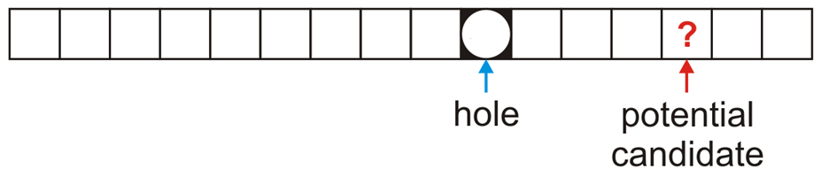
Erasing
In general, assume:
The currently removed object has created a hole at index hole
The object we are checking is located at the position index and has a hash value of hash

Slide 54
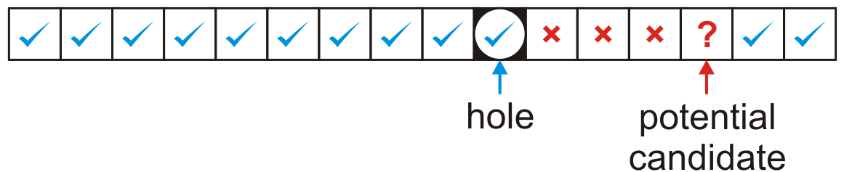
Erasing
The first possibility is that hole < index
In this case, the hash value of the object at index must either
equal to or less than the hole or
it must be greater than the index of the potential candidate
Remember: if we are checking the object ? at location index, this means that all entries between hole and index are both occupied and could not have been copied into the hole

Slide 55
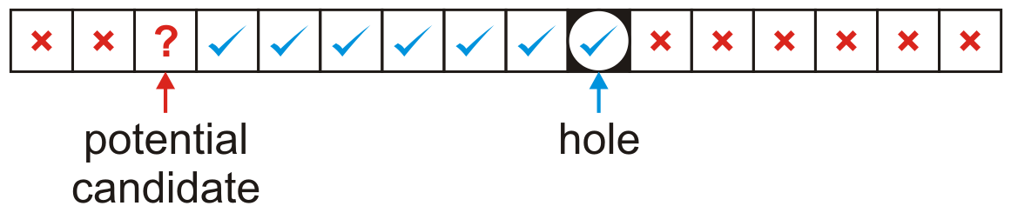
Erasing
The other possibility is we wrapped around the end of the array, that is, hole > index
In this case, the hash value of the object at index must be both
greater than the index of the potential candidate and
it must be less than or equal to the hole
In either case, if the move is successful, the ? Now becomes the new hole to be filled

Slide 56
Black Board Example
Using the last digit as our hash function—insert these nine numbers into a hash table of size M = 10
31, 15, 79, 55, 42, 99, 60, 80, 23
Then, remove 79, 31, 42, and 60, in that order

Slide 57
Primary Clustering
We have already observed the following phenomenon:
With more insertions, the contiguous regions (or clusters) get larger
This results in longer search times
0 | 1 | 2 | 3 | 4 | 5 | 6 | 7 | 8 | 9 | A | B | C | D | E | F | 10 | 11 | 12 | 13 | 14 | 15 | 16 | 17 | 18 | 19 | 1A | 1B | 1C | 1D | 1E | 1F
680 |  |  |  |  |  | 826 | 207 | 488 | 946 |  | C8B | 74C | ACD | 3AD |  |  | 946 | B32 |  |  |  |  |  |  | D59 | 5BA | 19A | E9C

Slide 58
Primary Clustering
We currently have three clusters of length four
0 | 1 | 2 | 3 | 4 | 5 | 6 | 7 | 8 | 9 | A | B | C | D | E | F | 10 | 11 | 12 | 13 | 14 | 15 | 16 | 17 | 18 | 19 | 1A | 1B | 1C | 1D | 1E | 1F
680 |  |  |  |  |  | 826 | 207 | 488 | 946 |  | C8B | 74C | ACD | 3AD |  |  | 946 | B32 |  |  |  |  |  |  | D59 | 5BA | 19A | E9C

Slide 59
Primary Clustering
There is a 5/32 ≈ 16 % chance that an insertion will fill Bin A
0 | 1 | 2 | 3 | 4 | 5 | 6 | 7 | 8 | 9 | A | B | C | D | E | F | 10 | 11 | 12 | 13 | 14 | 15 | 16 | 17 | 18 | 19 | 1A | 1B | 1C | 1D | 1E | 1F
680 |  |  |  |  |  | 826 | 207 | 488 | 946 |  | C8B | 74C | ACD | 3AD |  |  | 946 | B32 |  |  |  |  |  |  | D59 | 5BA | 19A | E9C

Slide 60
Primary Clustering
There is a 5/32 ≈ 16 % chance that an insertion will fill Bin A
This causes two clusters to coalesce into one larger cluster of length 9
0 | 1 | 2 | 3 | 4 | 5 | 6 | 7 | 8 | 9 | A | B | C | D | E | F | 10 | 11 | 12 | 13 | 14 | 15 | 16 | 17 | 18 | 19 | 1A | 1B | 1C | 1D | 1E | 1F
680 |  |  |  |  |  | 826 | 207 | 488 | 946 | 747 | C8B | 74C | ACD | 3AD |  |  | 946 | B32 |  |  |  |  |  |  | D59 | 5BA | 19A | E9C

Slide 61
Primary Clustering
There is now a 11/32 ≈ 34 % chance that the next insertion will increase the length of this cluster
0 | 1 | 2 | 3 | 4 | 5 | 6 | 7 | 8 | 9 | A | B | C | D | E | F | 10 | 11 | 12 | 13 | 14 | 15 | 16 | 17 | 18 | 19 | 1A | 1B | 1C | 1D | 1E | 1F
680 |  |  |  |  |  | 826 | 207 | 488 | 946 | 747 | C8B | 74C | ACD | 3AD |  |  | 946 | B32 |  |  |  |  |  |  | D59 | 5BA | 19A | E9C

Slide 62
Primary Clustering
As the cluster length increases, the probability of further increasing the length increases
In general:
Suppose that a cluster is of length ℓ
An insertion either into any bin occupied by the chain or into the locations immediately before or after it will increase the length of the chain
This gives a probability of
0 | 1 | 2 | 3 | 4 | 5 | 6 | 7 | 8 | 9 | A | B | C | D | E | F | 10 | 11 | 12 | 13 | 14 | 15 | 16 | 17 | 18 | 19 | 1A | 1B | 1C | 1D | 1E | 1F
680 |  |  |  |  |  | 826 | 207 | 488 | 946 | 747 | C8B | 74C | ACD | 3AD |  |  | 946 | B32 |  |  |  |  |  |  | D59 | 5BA | 19A | E9C

Slide 63
Run-time analysis
The length of these chains will affect the number of probes required to perform insertions, accesses, or removals
It is possible to estimate the average number of probes for a successful search, where λ is the load factor:
For example: if λ = 0.5, we require 1.5 probes on average
Reference: Knuth, The Art of Computer Programming, Vol. 3, 2nd Ed., Addison Wesley, 1998, p.528.

Slide 64
Run-time analysis
The number of probes for an unsuccessful search or for an insertion is higher:
For 0 ≤ λ ≤ 1, then (1 – λ)² ≤ 1 – λ, and therefore the reciprocal will be larger
Again, if λ = 0.5 then we require 2.5 probes on average
Reference: Knuth, The Art of Computer Programming, Vol. 3, 2nd Ed., Addison Wesley, 1998, p.528.

Slide 65
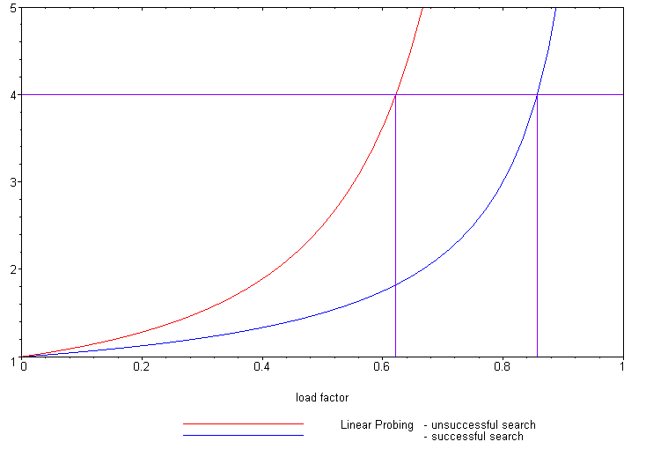
Run-time analysis
The following plot shows how the number of required probes increases

Slide 66
Run-time analysis
Our goal was to keep all operations Θ(1)
Unfortunate, as λ grows, so does the run time
One solution is to keep the load factor under a given bound
If we choose λ = 2/3, then the number of probes for either a successful or unsuccessful search is 2 and 5, respectively

Slide 67
Run-time analysis
Therefore, we have three choices:
Choose M large enough so that we will not pass this load factor
This could waste memory
Double the number of bins if the chosen load factor is reached
Not available if dynamic memory allocation is not available
Choose a different strategy from linear probing
Two possibilities are quadratic probing and double hashing

Slide 68
Summary
This topic introduced linear problem
Continue looking forward until an empty cell is found
Searching follows the same rule
Removing an object is more difficult
Primary clustering is an issue
Keep the load factor λ ≤ 2/3

Slide 69
References
Wikipedia, http://en.wikipedia.org/wiki/Hash_function
[1] Cormen, Leiserson, and Rivest, Introduction to Algorithms, McGraw Hill, 1990.
[2] Weiss, Data Structures and Algorithm Analysis in C++, 3rd Ed., Addison Wesley.
These slides are provided for the ECE 250 Algorithms and Data Structures course. The material in it reflects Douglas W. Harder’s best judgment in light of the information available to him at the time of preparation. Any reliance on these course slides by any party for any other purpose are the responsibility of such parties. Douglas W. Harder accepts no responsibility for damages, if any, suffered by any party as a result of decisions made or actions based on these course slides for any other purpose than that for which it was intended.

